Slide 1
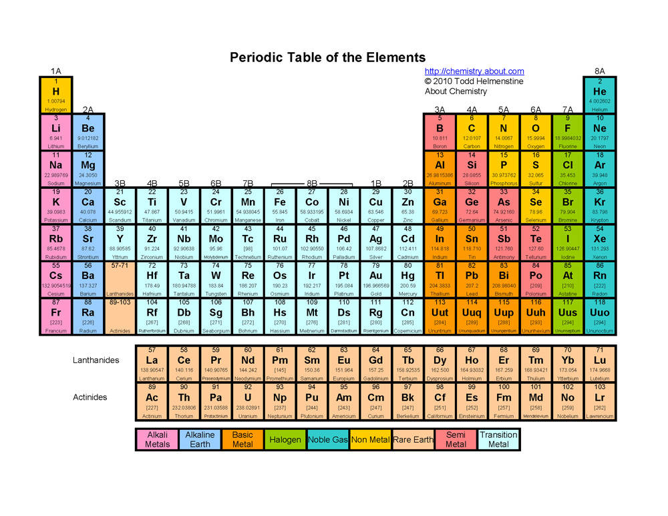
Periodic Table Groups & Colours

Slide 2
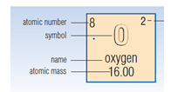
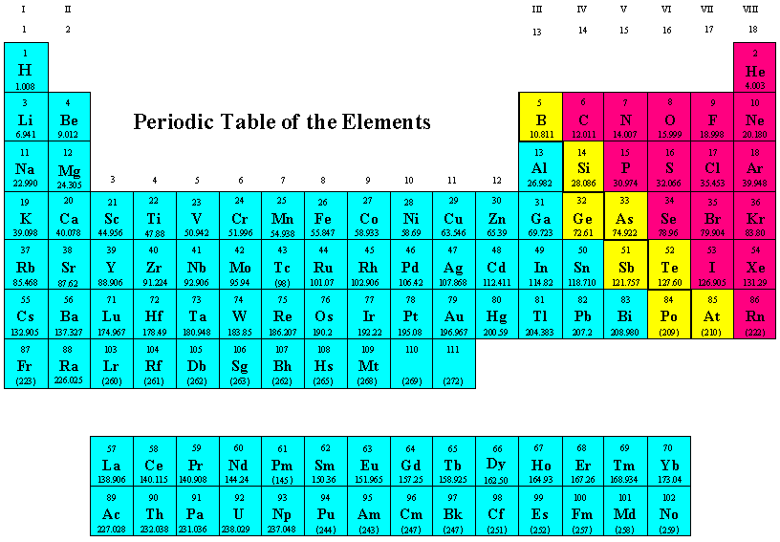
Periodic Table Names & Symbols
Non- Metals
Metals
Metalloids

